Slide 1
MongoDB Project Presentation
Project Title: Fitness Trackers Data Analysis Using MongoDB.
Student Name: dotun oduwale
Database: D597_Task_2.
Technology: MongoDB (NoSQL).

Slide 2
Project Overview:
Analysis of fitness trackers and smartwatches data.
Focus on extracting meaningful business insights.
Used MongoDB Aggregation Framework for analysis.
Key Objectives:
Average rating by brand.
Device type distribution.
Identification of long battery life devices.

Slide 3

Database & Collection Setup:
Database Name: D597_Task_2.
Collection Name: fitness_trackers.
MongoDB automatically creates the database and collection.
Command Used:
db.createCollection("fitness_trackers")

Slide 4
Logical Data Model:
The dataset follows a document-based data model, where each document represents one fitness device.
Fields Included:
_id (ObjectId)
Brand Name
Model Name
Device Type
Rating (Out of 5)
Average Battery Life (in days)
Benefit:
No joins required
Faster aggregation and analysis

Slide 5
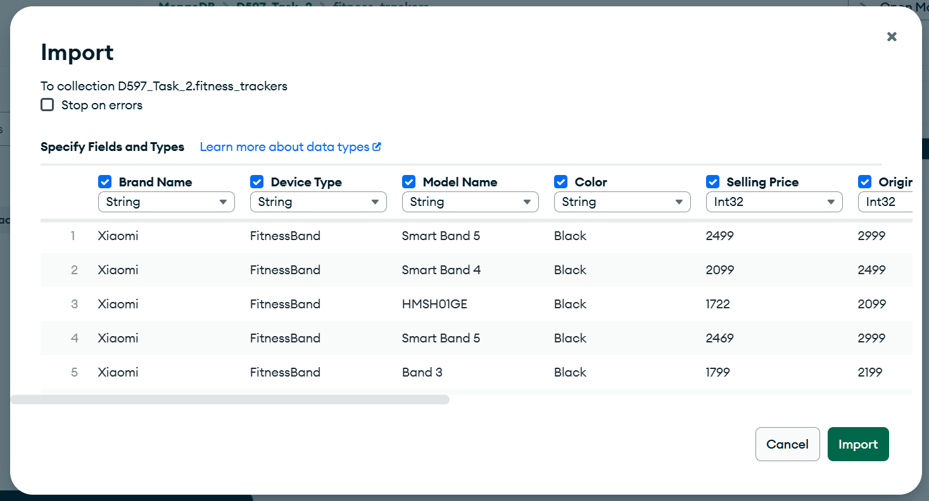
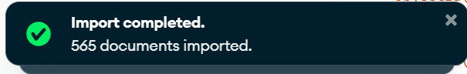
Data Insertion Method:
Data was imported using MongoDB Compass Import Tool.
Bulk import used instead of manual insert queries.
Records verified after successful import.

Slide 6
Data Cleaning & Transformation:
Rating values were stored as strings.
Converted to numeric values during analysis.
Technique Used:
$toDouble operator inside aggregation pipeline.
Purpose:
Accurate average and numerical calculations.

Slide 7
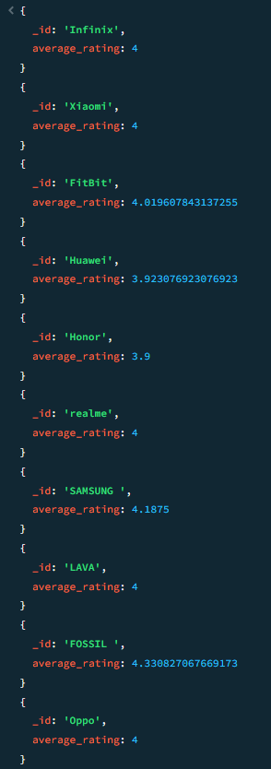
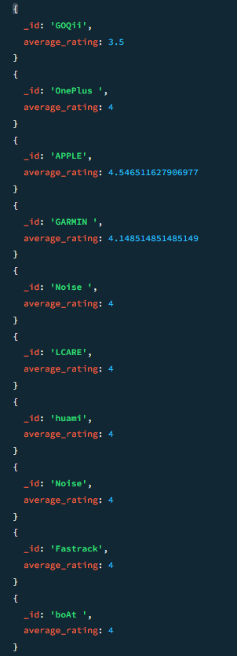
Query 1 – Average Rating by Brand:
Objective: Calculate the average rating for each brand.
Approach:
Convert rating to numeric.
Group data by brand.
Calculate average rating.
Query 1 – Output & Insight
Sample Results:
Apple: Highest average rating.
Fossil and Samsung: Strong user satisfaction.
Insight: Brands such as Apple, Fossil, and Samsung demonstrate higher customer satisfaction based on ratings.

Slide 8
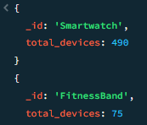
Query 2 – Device Type Distribution
Objective: Identify total devices by type.
Approach:
Group records by Device Type.
Count number of documents.
Query 2 – Output & Insight
Results:
Smartwatches: 490 devices.
Fitness Bands: 75 devices.
Insight: Smartwatches dominate the dataset, indicating higher market adoption compared to fitness bands.

Slide 9
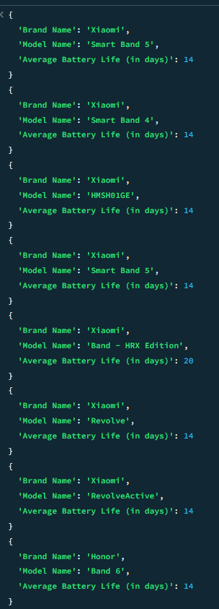
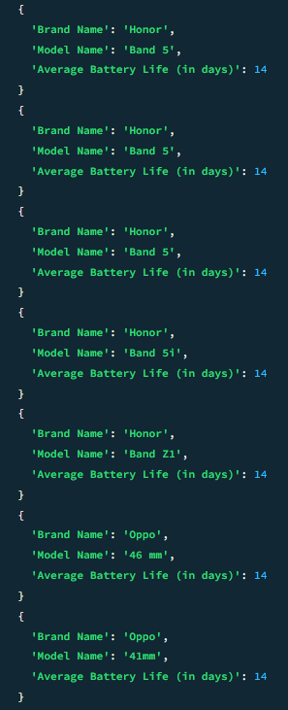
Query 3 – Devices with Battery Life ≥ 14 Days
Objective: Retrieve devices with long battery life.
Approach:
Filter devices using $gte on battery life.
Display brand, model, and battery life.
Query 3 – Output & Insight
Key Brands Identified:
Xiaomi
Honor
Oppo
Insight: These brands offer multiple devices with extended battery life, suitable for users prioritizing battery performance.

Slide 10
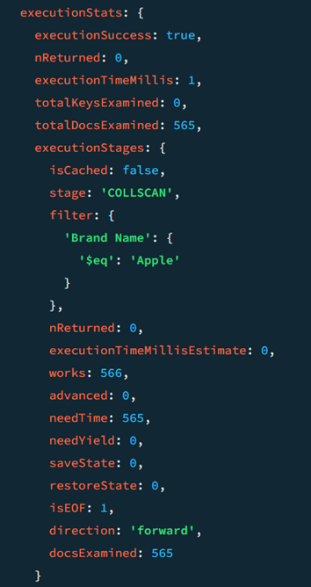
Query Optimization – Before Indexing
No indexes applied.
Full collection scan performed.
Full collection scan (COLLSCAN)

Slide 11
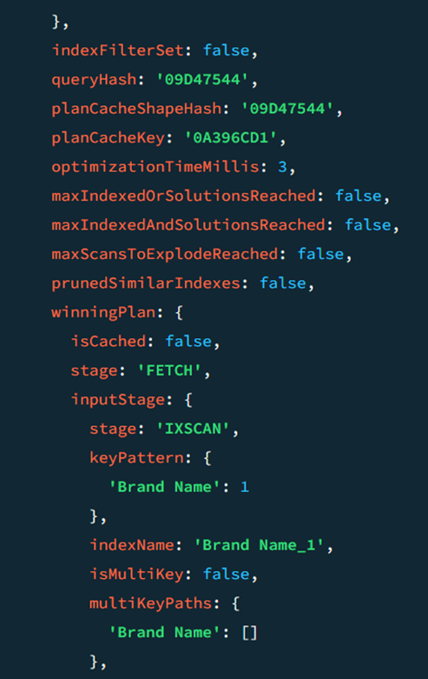
Query Optimization – After Indexing
Indexes Created On:
Brand Name
Rating (Out of 5)
Results:
Query plan shifted from COLLSCAN to IXSCAN.
Fewer documents were scanned.

Slide 12
Key Learnings:
Practical use of MongoDB aggregation framework.
Real-world data cleaning techniques.
Performance optimization using indexing.
Effective NoSQL data analysis.

Slide 13
Conclusion
MongoDB is effective for analytical workloads.
Aggregation pipelines simplify complex analysis.
Indexing significantly improves query performance.
Outcome: This project demonstrates hands-on experience with MongoDB, data modeling, optimization, and analysis.

Slide 14
Thank You
End of Presentation

